Slide 1

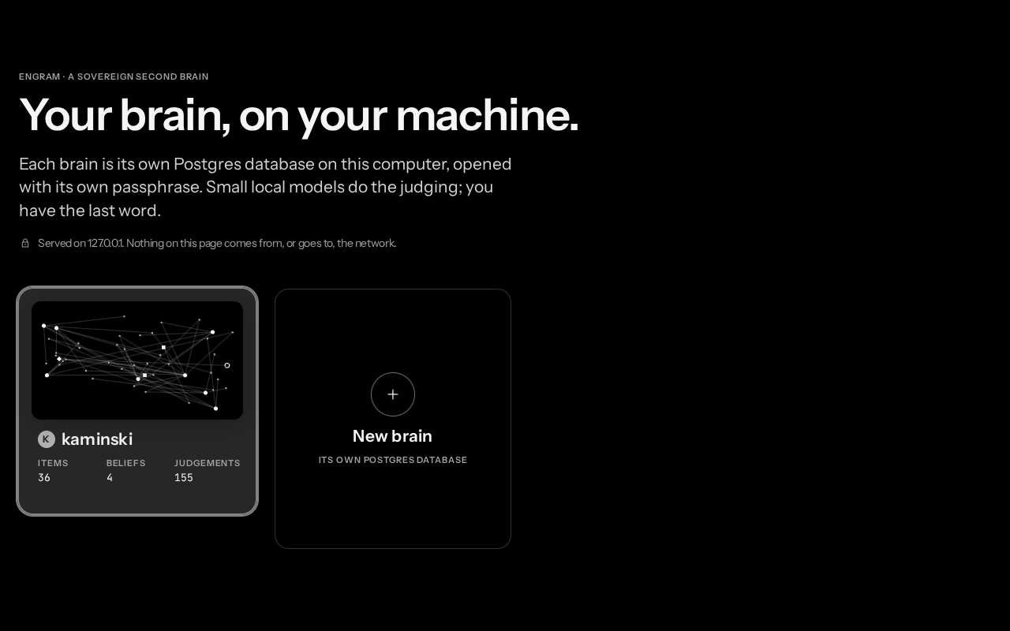
Omnitrix
A local AI secretary that remembers, plans and acts, only with your OK.
Brain: engram
Track 1 Sovereign AI
MSRIT Hackathon
Notes:
Omnitrix is a local AI secretary: it reads your email, meetings and notes, remembers what was promised and decided, plans your day, and acts only with your OK. Its brain, engram, runs entirely on one laptop. The screenshot is the real login screen: each brain is its own Postgres database, opened with its own passphrase.

Slide 2







The Problem:
Data Overload & Unreliable AI Memory
Context fragmentation
Broken AI memory
Privacy leaks
97.8%
41%
7.5%
Emails
Invites
Notes
junk in a Mem0 audit
Graphiti facts invalidated
Decisions scattered across emails, calendar invites and notes
3 of 4 audited invalidations were wrong
of queries leak private data in local + cloud delegation (PAPILLON)
Omnitrix · MSRIT Hackathon · Track 1 Sovereign AI 02
Notes:
The problem is data overload plus unreliable AI memory. First, context is fragmented: the decisions that matter are buried across scattered emails, calendar invites and messy notes. Second, today's memory frameworks break: an audit of 10,134 Mem0 memories found 97.8% junk, and Graphiti's small-model judge silently invalidated 41% of about 3,950 facts, with 3 of 4 audited cases wrong. Third, privacy: even careful local + cloud delegation leaks private data on 7.5% of queries (PAPILLON).

Slide 3



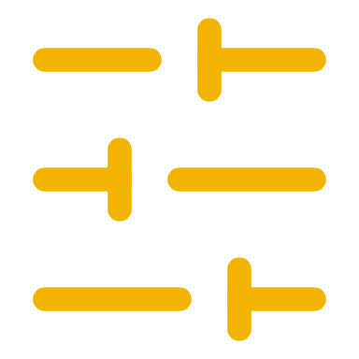


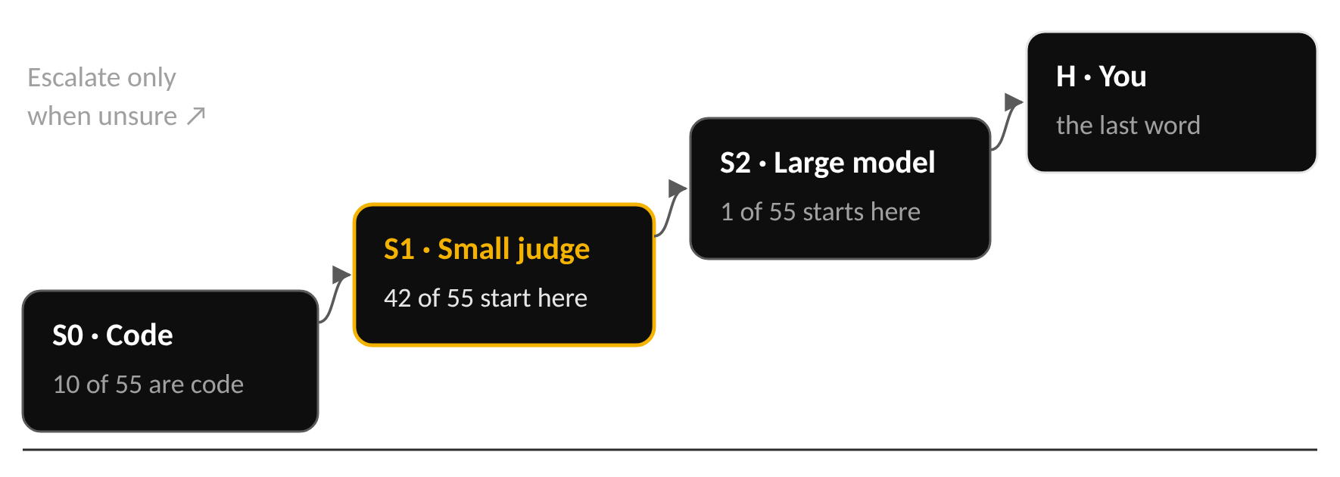
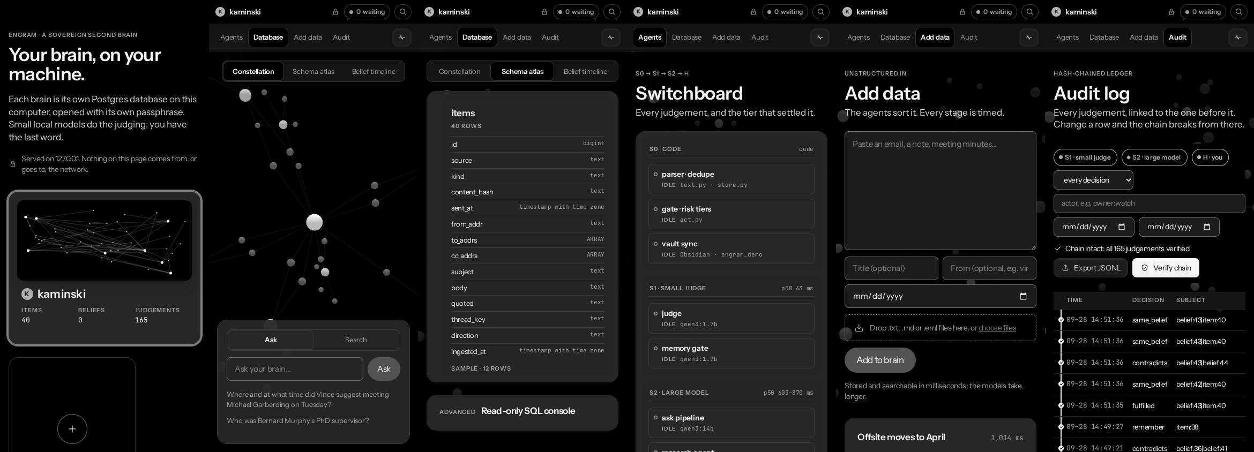
Our answer: a personal AI.
Personal AI
Locally hosted
Fine-tuned LLM
Society of LLMs
Second brain
learns how you judge
zero cloud calls
a 1.7B trained on you
fast small, slow large, you
memory with sources
How it decides
The engram web app, on a phone
Omnitrix · MSRIT Hackathon · Track 1 Sovereign AI 03
Notes:
Our answer is a personal AI that learns how you judge, runs locally with zero cloud calls, and uses a 1.7B model fine-tuned on you. It is a society of models: code first, a fast small judge, a slow large model, and you, escalating only when unsure. Of the 55 judgements a brain needs, 10 are pure code, 42 go to the small judge first, and only 1 needs the large model first.

Slide 4

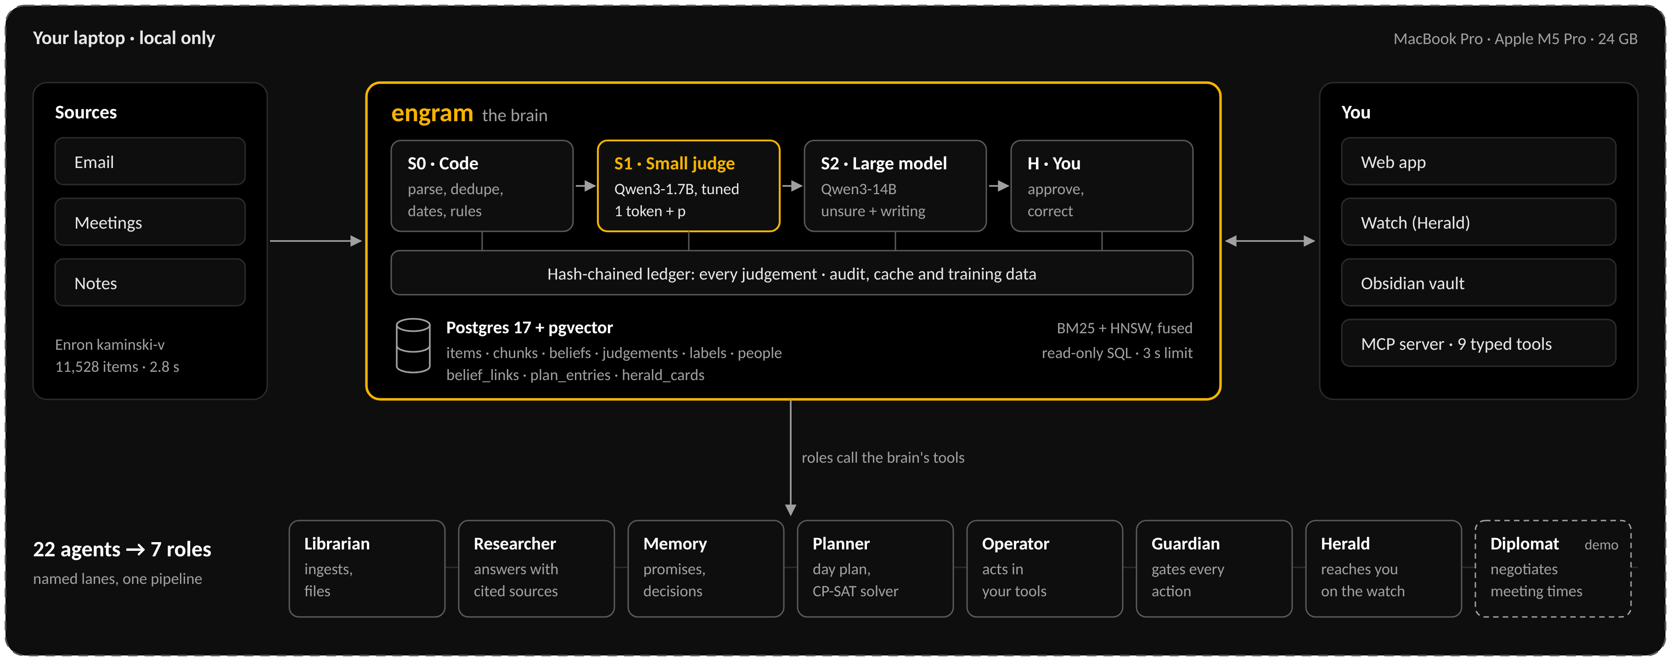
The brain and its society of agents.
Omnitrix · MSRIT Hackathon · Track 1 Sovereign AI 04
Notes:
Everything runs inside one laptop: sources flow into engram, which thinks in four tiers (code, a small judge, a large model, you) and writes every judgement to one hash-chained ledger that is also its audit log, cache and training data. Memory, search (BM25 + pgvector HNSW, 1.9 ms keyword, 28 ms hybrid) and the ledger are plain Postgres tables, with a read-only SQL console and one MCP server with 9 typed tools. We merged 22 planned agents into 7 roles on one pipeline because sequential multi-agent setups lose 39–70% and amplify errors up to 17.2× (Kim et al.), 44.2% of multi-agent failures come from system design (MAST), persona prompts don't improve accuracy across 162 roles, and LLMs manage 33–48% on calendar planning while a solver-checked plan reaches 93.9%.

Slide 5
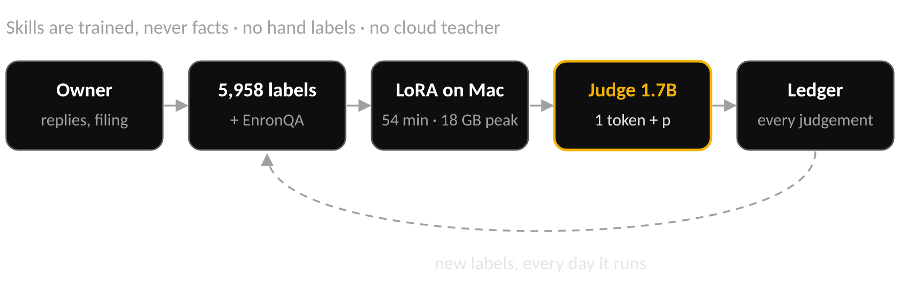
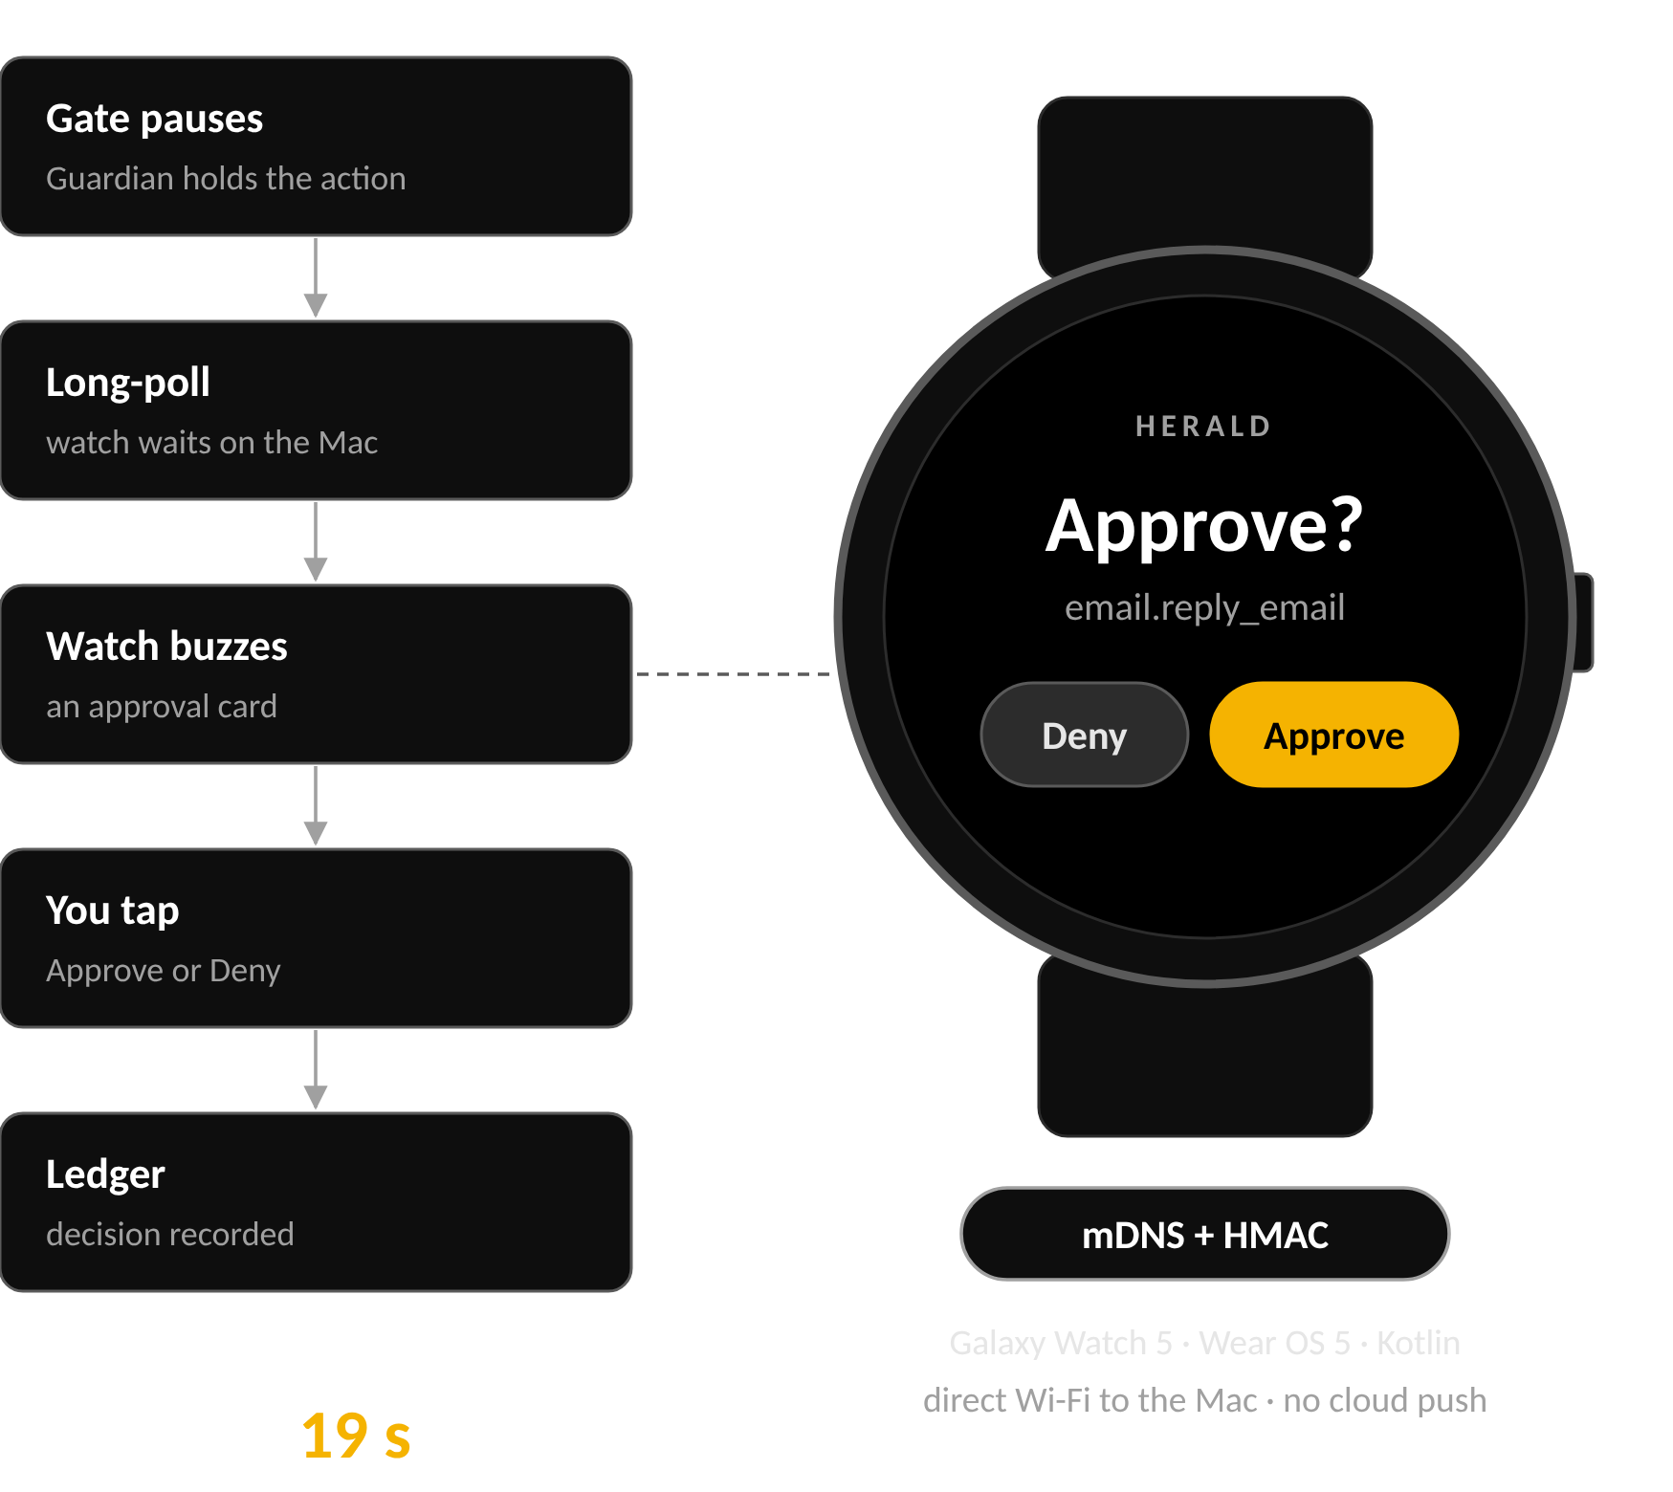
Fine-tuned on you, approved on your wrist.
Held-out accuracy, %
Omnitrix · MSRIT Hackathon · Track 1 Sovereign AI 05
Notes:
We fine-tune Qwen3-1.7B with LoRA in 54 minutes on the laptop (MLX, 18 GB peak), using 5,958 labels the brain already had: the owner's own replies and filing plus EnronQA answers, with no hand labelling and no cloud teacher. The tuned 1.7B beats its base and the 14B zero-shot on all four held-out decisions and is 3–5× faster than the 14B; fused and 4-bit it is 934 MB at 214 ms per email, and it settles 82.6% of 'supported?' on its own at 99.3% accuracy. On the right, Herald: a Kotlin app on a Galaxy Watch 5 long-polls the Mac over direct Wi-Fi, found by mDNS with an HMAC challenge, and a real sandbox email reply was approved on the wrist and ledgered 19 s after the gate paused.

Slide 6


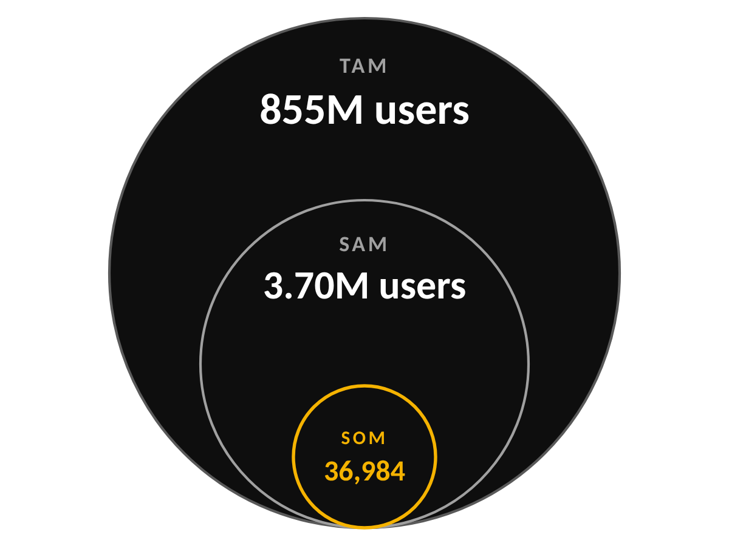



Impact: private, personal, faster.
Private
Personalised
Simplified
0
96.6%
7 roles
cloud calls; every model runs locally
fine-tuned 1.7B vs 95.5% for the 14B
and one watch tap to approve
Time
Cost
Accuracy
TAM 1.14B knowledge workers × 75% using AI = 855M × ₹23,988/yr ≈ ₹20.5 lakh crore
SAM India's advocates, CAs, doctors and startups: 40.2 lakh × 92% using AI = 3.70M × ₹23,988 ≈ ₹8,872 crore
SOM 1% of SAM in 3 years (our assumption) = 36,984 × ₹23,988 ≈ ₹88.7 crore
Price benchmark: ChatGPT Plus in India, ₹1,999/month. Sources on slide 8.
807 s → 255 s
3–5×
40.0% → 6.7%
memory gate on 60 emails
faster than the 14B · 934 MB · no API costs
harmful side effects on 60 sandbox tasks
Omnitrix · MSRIT Hackathon · Track 1 Sovereign AI 06
Notes:
Every tile is a measured result: the memory gate cut 807 s to 255 s on 60 emails and 151 beliefs to 36; answering dropped from a 21 s to an 11 s median; and the action gate cut harmful side effects from 40.0% to 6.7% while tasks done right rose from 38.3% to 48.3%, with 0.62 owner prompts per task against 0.97 for approve-everything. The market figures are top-down: TAM uses Gartner's 1.14B knowledge workers and Microsoft's 75% AI use; SAM counts India's regulated professionals and DPIIT startups (one founder per startup) with Microsoft's 92% India AI use; SOM is our own 1% three-year assumption, priced at the ChatGPT Plus India benchmark. TODO: filter SAM by laptops able to run local models; we found no citable figure.

Slide 7






Feasible today, on one laptop.
Compute
Brain latency log scale
Privacy
24 GB
Zero cloud calls
one MacBook Pro, Apple M5 Pro
Hash-chained ledger
DPDP-ready
934 MB
fused 4-bit judge
up to ₹250 crore
54 min
DPDP Rules 2025 penalty, from ~May 2027
LoRA training · 18 GB peak
Runs today on hardware the owner already has.
Omnitrix · MSRIT Hackathon · Track 1 Sovereign AI 07
Notes:
Compute is one 24 GB laptop: the fused 4-bit judge is 934 MB and training took 54 minutes at an 18 GB peak. Latency is on a log scale: keyword search 1.9 ms, hybrid 28 ms, an item is searchable 13 ms after it arrives, the judge takes 214 ms per email, Whisper about 0.5 s for a 2.5 s clip, and answers 11 s median or 1.7 s in draft mode. On privacy, India's DPDP Rules 2025 bring 1-year access logs, 72-hour breach reports and penalties up to ₹250 crore from about May 2027, and vendor kill-switches are real (Rewind's local capture disabled Dec 2025, Mem0's local server sunset Jul 2026). Honest limits: 'will they reply?' is only 60.1% so it stays a suggestion; the watch speaks plain HTTP on the LAN and drops Wi-Fi when it sleeps with Bluetooth on; v2 lost ground on round-1 decisions so those stay on v1; and 'zero cloud calls' comes from the architecture, not a network capture.

Slide 8


References and sources.
Research and evidence
Data, models and market
Kim et al. Multi-agent scaling across 180 configurations. arXiv:2512.08296
Cemri et al. MAST: why multi-agent systems fail. arXiv:2503.13657
Zheng et al. Persona prompts don't improve accuracy. arXiv:2311.10054
NATURAL PLAN. arXiv:2406.04520
A solver-checked LLM planner (10% → 93.9%). arXiv:2404.11891
NVIDIA. Small Language Models are the Future of Agentic AI. arXiv:2506.02153
PAPILLON (NAACL 2025): local + cloud delegation leaks 7.5%
Mem0 memory audit (mem0 issue #4573); Graphiti invalidation report (graphiti issue #1728)
India's Digital Personal Data Protection Rules, 2025
Datasets: EnronQA (CC BY 4.0), WorkBench (MIT), QMSum / AMI
Models and tools: Qwen3-1.7B, Qwen3-14B, Whisper large-v3-turbo, MLX, Ollama, PostgreSQL + pgvector, OR-Tools CP-SAT
Market (TAM / SAM / SOM)
Gartner press release, 24 Sep 2019: 1.14B knowledge workers by 2023
Microsoft & LinkedIn, 2024 Work Trend Index: 75% of knowledge workers use AI
Microsoft India, 16 May 2024: 92% of Indian knowledge workers use AI
Ministry of Law & Justice, Rajya Sabha reply (LawChakra, 25 Oct 2025): 20,13,081 advocates
ICAI 76th Annual Report 2024-25: 4,23,105 members
MoS Health, Rajya Sabha reply (1 Apr 2025): 13,86,150 allopathic doctors
DPIIT via PIB, 2 Dec 2025: 1,97,692 recognised startups
TechCrunch, 18 Aug 2025: ChatGPT Plus ₹1,999/month in India
Omnitrix · MSRIT Hackathon · Track 1 Sovereign AI 08
Notes:
Research references are the ones behind each claim in the deck; the market sources back the TAM, SAM and SOM on slide 6. The ₹1,999 price is a benchmark from August 2025 and may have changed; the Gartner figure is a 2019 forecast for 2023, so the TAM is indicative.

Slide 9

Thank you
Your brain, on your machine.
github.com/tharanirmal/omnitrix
Repo
Team
Omnitrix · MSRIT Hackathon · Track 1 Sovereign AI 09
Notes:
Omnitrix keeps your brain on your machine: it remembers, plans and acts, and only with your OK. The code is at github.com/tharanirmal/omnitrix. Thank you; we're happy to take questions or show the live demo.

